Slide 1

React Native
A JavaScript library for building cross-platform mobile apps

Slide 2
React Native, what, why and when?

Slide 3

What is react-native.
Why the world needed it.
How does react-native works
Speed setup, Expo !
Up and Running
Styling & Flexbox
Views
Rendering Text
Touchables
ScrollView
Lists
TextInput
Remote Requests
State management with context API
React Navigation
& Routing
External Packages
Agenda
Notes:
https://github.com/grab/front-end-guide

Slide 4
console.info(‘Hello, I am Ahmed Hamza!’);
// Software Engineer @_VOIS

Slide 5
What is React...
React.Js is a JS library used for building user interfaces, React is a platform-agnostic, It means:-
react + react native = Mobile Development.
react + react-dom = Web Development.
Notes:
https://auth0.com/blog/javascript-module-systems-showdown/

Slide 6
What is React Native ?!
// cross-platform SDK

Slide 7
What is React Native...
React Native is a collection of special react components, these components are compiled to native UI elements.
React Native lets you build mobile apps , React Native is like react dom, It connects React to a specific platform.
It was created by Facebook in 2015 as open-source project.
It’s used in large applications like Instagram, AirBnB and UberEats
Notes:
https://auth0.com/blog/javascript-module-systems-showdown/

Slide 8
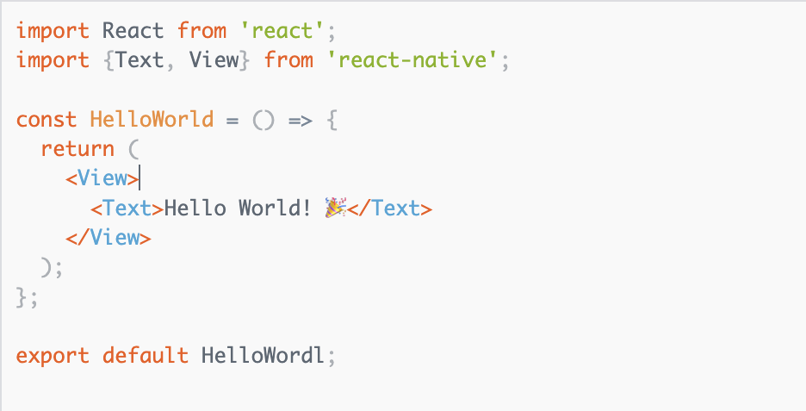
React native code example
Notes:
https://auth0.com/blog/javascript-module-systems-showdown/

Slide 9
Why the world needed React Native...
React Native lets you build mobile applications that work on Android and IOS with the same code base.
The development time is cut to half
Reusable components
It renders native UI views for every platform, and not web views
So, It’s fast and feel like native apps
Notes:
https://auth0.com/blog/javascript-module-systems-showdown/

Slide 10
How does React Native work
React Native compiles the JSX code to the real native app, not compiles the JS code(the logic) itself.
The logic is not compiled, It’s running on a JS thread that’s hosted by react native (in the app).
This is made possible by a javascript bridge, a javascript
thread called (JavascriptCore) running in the background to
handle communication between native APIs and JS code
Notes:
https://auth0.com/blog/javascript-module-systems-showdown/

Slide 11
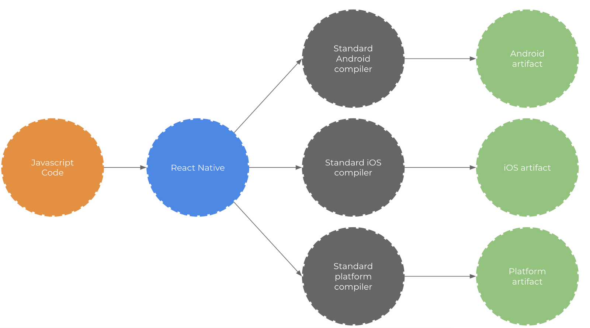

Slide 12
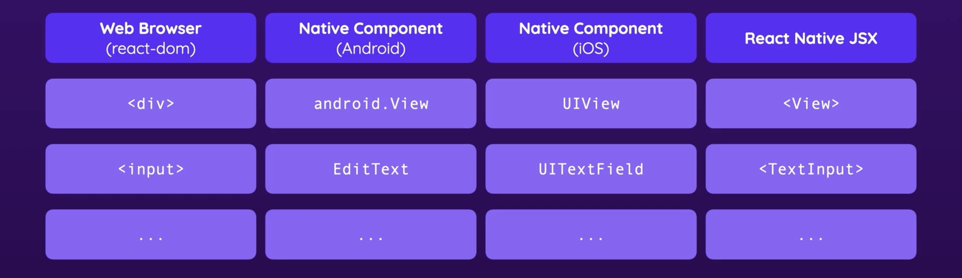

Slide 13
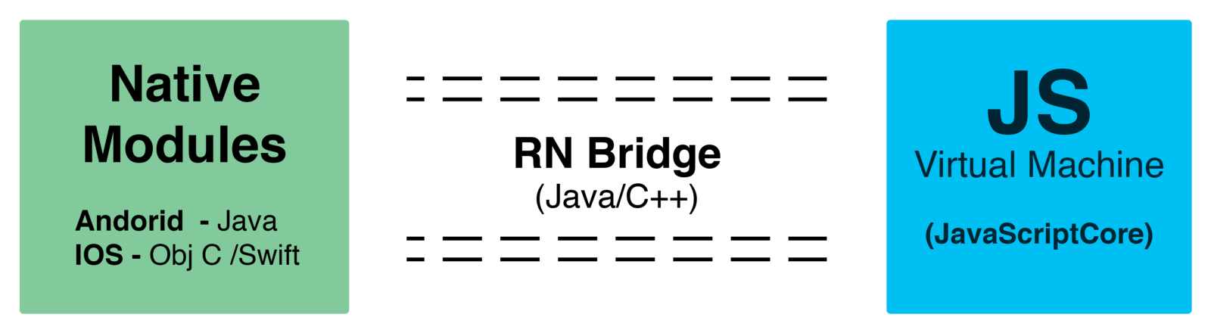

Slide 14

Speed Setup, EXPO
Notes:
http://es6-features.org/#Constants
http://blog.revathskumar.com/2016/02/reactjs-writing-in-es6.html

Slide 15
What is Expo and why it’s useful?
EXPO is a free third-part service can manage the react native app development workflow. (Expo is an echosystem)
It offers a lot of tooling and setup to make it much easier for developers to start building apps
Support for iOS and Android.
Push Notifications
Facebook login
Instant Updating
Over the air updates
A ton of useful libraries (i.e icons)
Easy to leave the expo echo system anytime to React Native Cli.
But no native modules :(
Notes:
https://auth0.com/blog/javascript-module-systems-showdown/

Slide 16
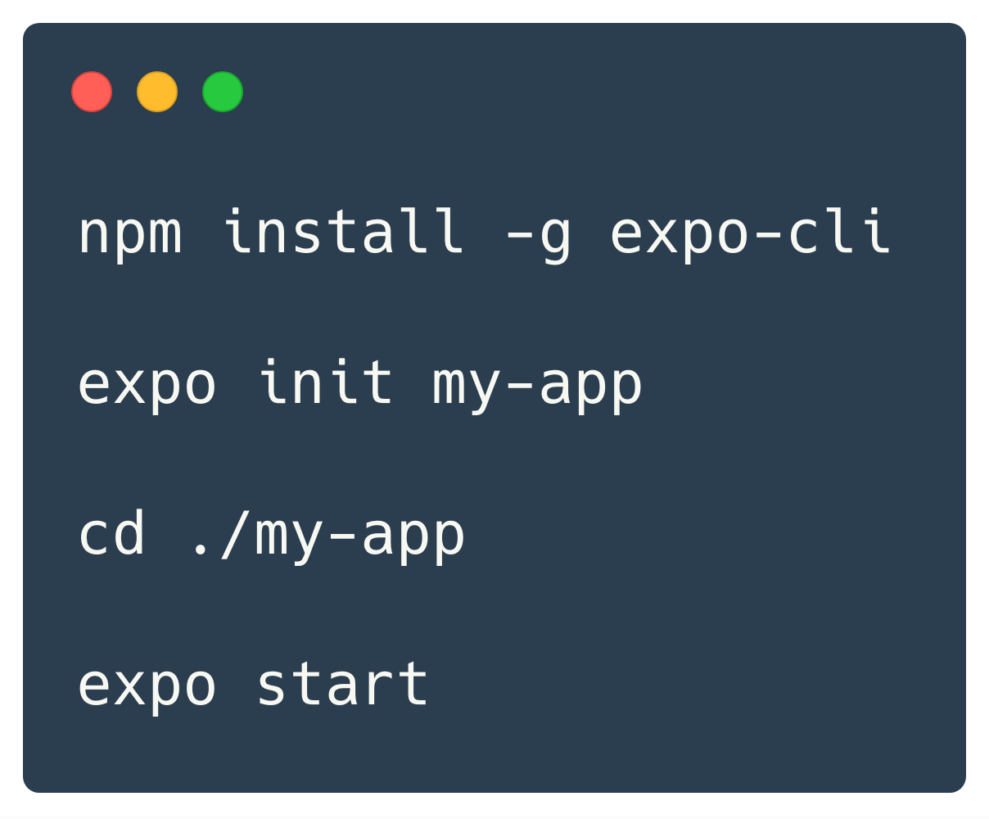
Expo installation and creating an app
Notes:
https://auth0.com/blog/javascript-module-systems-showdown/

Slide 17
Component Mapping
<div />
<View />
<p />
<Text />
<img />
<Image />
<ul />
<FlatList />
<input />
<TextInput />
<button />
<TouchableOpacity />
Notes:
https://developer.mozilla.org/en-US/docs/Web/Web_Components
https://github.com/mdn/web-components-examples/tree/master/edit-word
https://github.com/praveenpuglia/shadow-dom-in-depth
https://www.youtube.com/watch?v=SDs4xmMcVS4
https://www.html5rocks.com/en/tutorials/webcomponents/shadowdom/

Slide 18
<View />
https://facebook.github.io/react-native/docs/view

Slide 19
<Text />
https://facebook.github.io/react-native/docs/text

Slide 20
<SafeAreaView/>
https://reactnative.dev/docs/safeareaview

Slide 21
<ScrollView />
https://facebook.github.io/react-native/docs/scrollview

Slide 22
<FlatList />
https://facebook.github.io/react-native/docs/flatlist

Slide 23
<Image />
https://facebook.github.io/react-native/docs/image

Slide 24
<TextInput />
https://facebook.github.io/react-native/docs/textinput

Slide 25
<TouchableOpacity />
https://facebook.github.io/react-native/docs/touchableopacity

Slide 26
Styling in React Native
You can style your application using JavaScript, All core components has prop called style
It usually like CSS but names are written using camel casing, (e.g. margin-left => marginLeft)
We have 2 ways for styling our app :-
Inline styles
Stylesheet Objects
Notes:
https://auth0.com/blog/javascript-module-systems-showdown/

Slide 27

TODO app
Make todomvc-like app
http://todomvc.com/examples/react/#/

Slide 28
React Navigation

Slide 29
What is react-navigation?
react-navigation is the most common used library to handle routing and navigation
It provide a lot of useful APIs like different kinds of navigators, styles, animation and sharing data (params) between screens
Navigators can be nested inside each other very screen could be a navigator.
Most used navigators:
Stack navigator
Bottom tap navigator
Drawer navigator
In project directory run: npm install @react-navigation/native
Notes:
https://auth0.com/blog/javascript-module-systems-showdown/

Slide 30
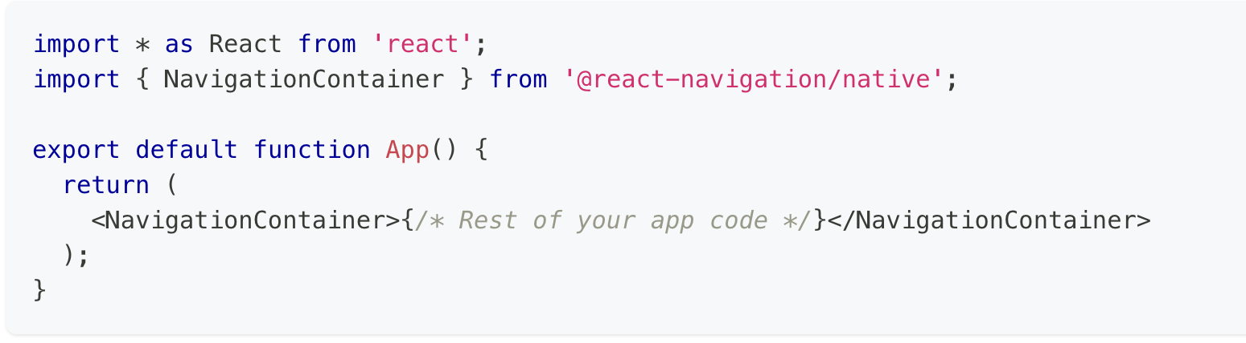
Setup
We create a container that has all routes
Notes:
https://auth0.com/blog/javascript-module-systems-showdown/

Slide 31
createNativeStackNavigator()
In project directory run: npm install @react-navigation/native-stack
Define: const Stack = createNativeStackNavigator();
Function that returns an object containing 2 properties: Screen and Navigator. Both of them are React components used for configuring the navigator. The Navigator should contain Screen elements as its children to define the configuration for routes.
Notes:
https://auth0.com/blog/javascript-module-systems-showdown/

Slide 32
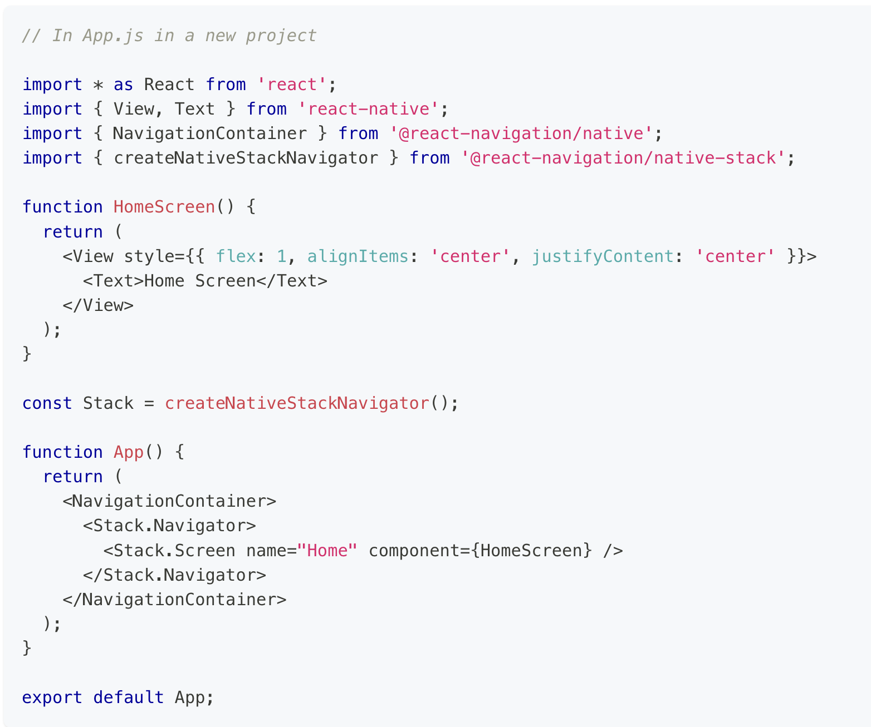
Notes:
https://auth0.com/blog/javascript-module-systems-showdown/

Slide 33
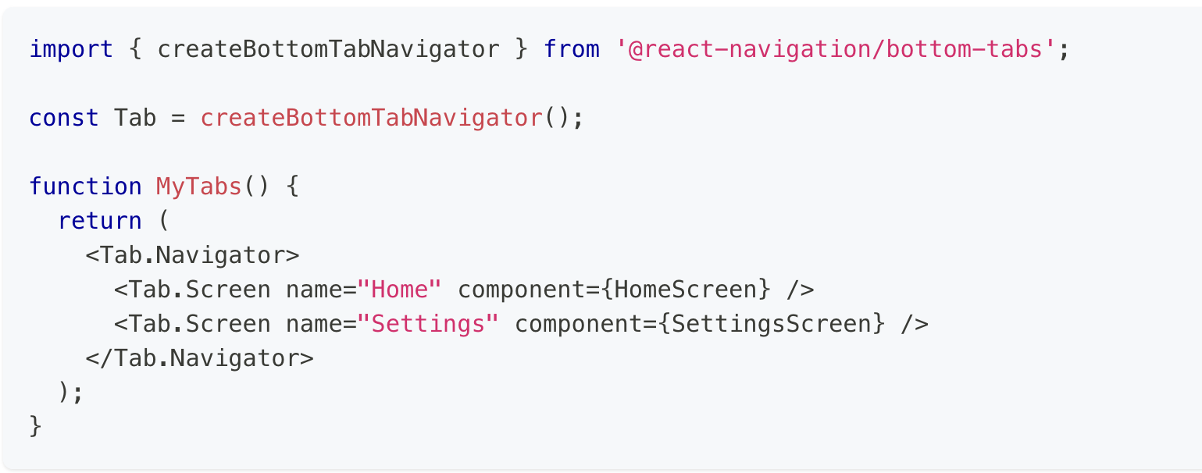
createBottomTabNavigator()
Notes:
https://auth0.com/blog/javascript-module-systems-showdown/

Slide 34
navigationOptions
For every screen there is an property called navigationOptions which is an object that containes config for this screen similart to options of defaultNavigationOptions
Options like:
header
headerStyle
headerTitle
headerLeft
headerRight
...etc
Notes:
https://auth0.com/blog/javascript-module-systems-showdown/

Slide 35
Sharing data among screens
Passing parameters to routes
(https://reactnavigation.org/docs/param)
Notes:
https://auth0.com/blog/javascript-module-systems-showdown/

Slide 36
Utilities - AsyncStorage
(https://www.npmjs.com/package/@react-native-async-storage/async-storage)
Like localstorage in the web AsyncStorage can save strings locally
AsyncStorage.setItem(‘token’, ‘b1k3rb1h34h23235bkn23dgvg45gv54j35j’)
AsyncStorage.getItem(‘token’)
AsyncStorage.clear()
If you need to save complex data you should JSON.stringify(it) first.
Be careful, it’s Asynchronous
Notes:
https://auth0.com/blog/javascript-module-systems-showdown/

Slide 37
Utilities - Platform
import { Platform } from ‘react-native’;
Use Platform from react native to check the OS the app is running on by Platform.OS
It has two values: ‘android’ & ‘ios’
Notes:
https://auth0.com/blog/javascript-module-systems-showdown/

Slide 38
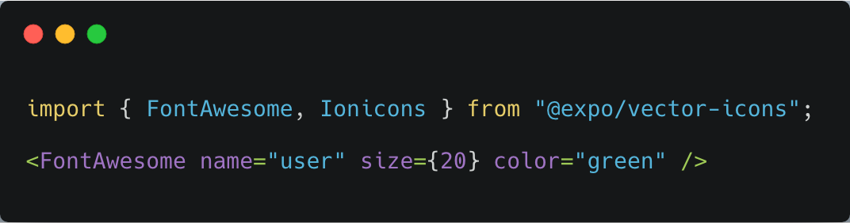
Utilities - ICONS
Notes:
https://auth0.com/blog/javascript-module-systems-showdown/

Slide 39
Using External Packages
Open source community has made a lot of reusable components that can be used in your app
React native awesome list
https://github.com/jondot/awesome-react-native
JS Coach:
https://js.coach/
Notes:
https://auth0.com/blog/javascript-module-systems-showdown/

Slide 40
Thanks :)

